Slide 1
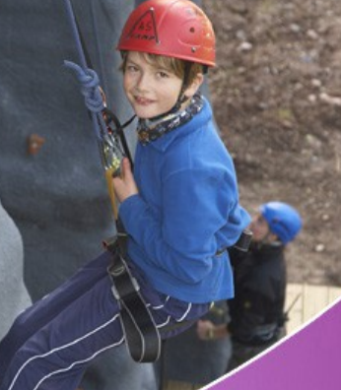
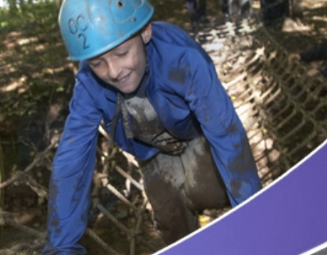
Year 5 –Manor Adventure, Norfolk Lakes
19th April – 21st April 2023

Slide 2
Agenda
Who’s going
Basic itinerary
Planning: Food/ Packing/consents/activities/groupings/ expectations
Risk assessments –Activities
Next steps

Slide 3
Who’s going
Mr Doyle
Miss Eaton
Mr Burch
TBC
And a group of lovely Year 5 children!

Slide 4
Planned itinerary!
Weds:
11.45am Arrive at school
11.50am Meet in hall and give any medications to Mr Doyle
12.15pm Board coach
12.30pm Depart Halifax
2.30pm Arrive at Manor Adventure
2.30 – 3.00pm Meet at site and orientate
3.30 – 5.00 First activity
5.15 – 6.30 Second activity
7.00 Evening meal
7.30 – 9.00 Activities
9.15 Bed and sleep!

Slide 5
Planned itinerary!
Thursday:
7.00 – 9.00 Breakfast
9.00 – 10.30 Activity 3
10.30 – 12.00 Activity 4
12.00 – 2.00 Lunch and free time
2.00 – 3.30 Activity 5
3.30 – 5.00 Activity 6
5.00 – 7.00 Dinner
7.00 – 9.00 Evening activity – Manor Olympics
9.00 Bed!! (Earlier than night before!)

Slide 6
Planned itinerary!
Friday:
7.00 – 9.00 Breakfast/pack!
9.00 – 10.30 Activity 7
10.30 – 12.00 Activity 8
12.00 – 1.00 Lunch and free time
1.30pm Depart centre
3.00 – 3.15 Arrive back at school
With lots of great memories and exhausted children.... And adults…..

Slide 7
Planning – consents
Parents/carers will have completed the parental consent/medical forms.
Please any update medical forms as required and give to me as soon as possible.
Any medications will need to be given to Mr Doyle on the morning of the trip in clearly labelled bags with any further instructions as required – please contact me in advance to discuss any specific details.
I will look after the medications and administer as required. Please ensure inhalers are also sent in as required. Children/group leader will be responsible for these when visiting activities.

Slide 8
Activities!
Our activity program may include:
Bouldering
Survival skills
Archery
Obstacle Course
Low Ropes
Canoeing
Kayaks
Giant Stand Up Paddle Board
Manor Olympics
Children will be in four groups of 10/11 each accompanied by a group leader

Slide 9
Food!
A very important part of any trip!
Water bottle please.
Manor Adventure menus vary day-to-day. There is always a choice of hot and cold dishes, vegetarian options, and fresh salad bar. Meals are served in a communal dining area.
Any dietary requirements I will ensure have been passed on to Manor Adventure before we visit as per the information provided by you.

Slide 10
Activity groups/dormitories
Dorms accommodate either 4 – 6 children.
Children will be choosing their dormitory groups tomorrow (with our guidance)
Activity groups have been made up in consultation with the Year 5 team to get a balance of boys/girls and across the classes.
Dormitories are simply furnished with bunk beds – a bottom sheet is provided.
Children to bring a sleeping bag and a pillow with pillow case.

Slide 11
Behaviour expectations
A very important part of any trip
As the pupils are representing themselves and the school we expect the same high standards of behaviour that we see in school.
Safety is paramount during activities and instructors will be monitoring and looking for behaviour to ensure this – supported by our staff.
If an instructor/member of staff feels that a child is not listening/showing appropriate behaviour then they will be removed from the activity and may forego further activities.
In severe incidents you will be contacted and expected to collect your child from the site.

Slide 12
What to pack
One case/holdall and one drawstring/lightweight ruck sack
Sleeping bag/pillow and pillowcase
A drink bottle
Torch
Toiletries (roll on deodorant)
Clothes for activity sessions:
Old clothes for activity sessions –long sleeved shirts, jumpers, trousers, jogging bottoms (not jeans)
T-Shirts and closed toe shoes are required for most sessions so bring plenty
T shirts, shoes, trousers for other times.
Waterproof clothing – jacket/trousers
Large plastic bag for dirty clothes
Bath towels x 2
Sun cream/hat (if we’re lucky!)
Pyjamas and slippers

Slide 13
What to pack – other items
One case/holdall and one drawstring/lightweight ruck sack
A reading book
Playing cards/a small game
Money for snacks (sweets/drinks, souvenirs.
£5 maximum in coins not notes

Slide 14
What not to take!
No jewellery
No wellies
No Aerosols
Denim jeans are not ideal for outdoor adventure activities
No mobile phones/electronic devices
No additional snacks

Slide 15
Risk Assessments
Safety is paramount in all we do.
All staff have risk assessments for the visit, including those from Manor Adventure relating to activities.
Manor Adventure has the LoTC accreditation in line with this.
Children will be made aware of the need to follow instructions for their and our safety throughout.

Slide 16
Next steps...
Please complete the online form and pay the £50 deposit by Thursday 6th October.
We will then outline the payment schedule in instalments culiminating in payments being collected before February half-term.
Please contact the school tomorrow if you have any questions.

Slide 17
Thank you!

